Slide 1
TECHNICAL HUB POWER BILL ANALYSIS DASHBOARD
USING MICROSOFT FABRIC

Slide 2
Our Project Path
We created Synthetic data for Power Bill for an entire year in order to perform month , day and year wise analysis
Creating Synthetic data
Modelling the Data
Modelled the data using multiple the modelling tools in Power BI
Building Relationships
Build Relationships between the two datasets
Querying and Visualization
Created Queries for those relationships followed by Visualization

Slide 3
Analysis
Analyzing the data to build relationships
Accessing the load on and off information using IoT through API and representing visually
Access
What We Are Looking To Achieve
Visualization
Creating Visuals regarding the power bill analysis with respective to date
Can get the information about the power bill in required format like day, month and Year
Facilitative

Slide 4
Points Of Service
Operation Team
Cost Effective
Helps Operation Team to get the data about the reading consumed and units billed
Can Know about the heavy consumption and can minimize it by taking required measures
Visibility
Rather than viewing the data in tabular format it gives good appeal to resemble everything visually

Slide 5
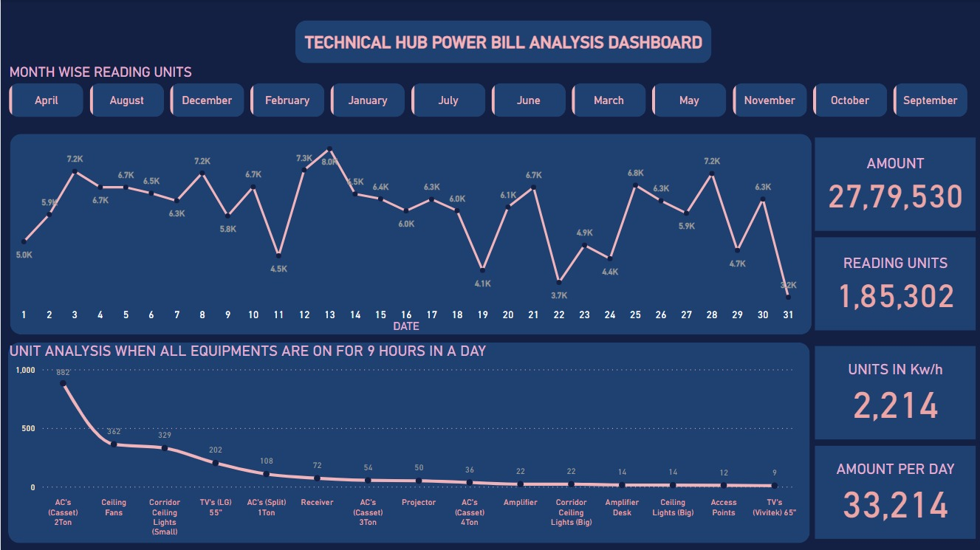
OUR ANALYSIS

Slide 6
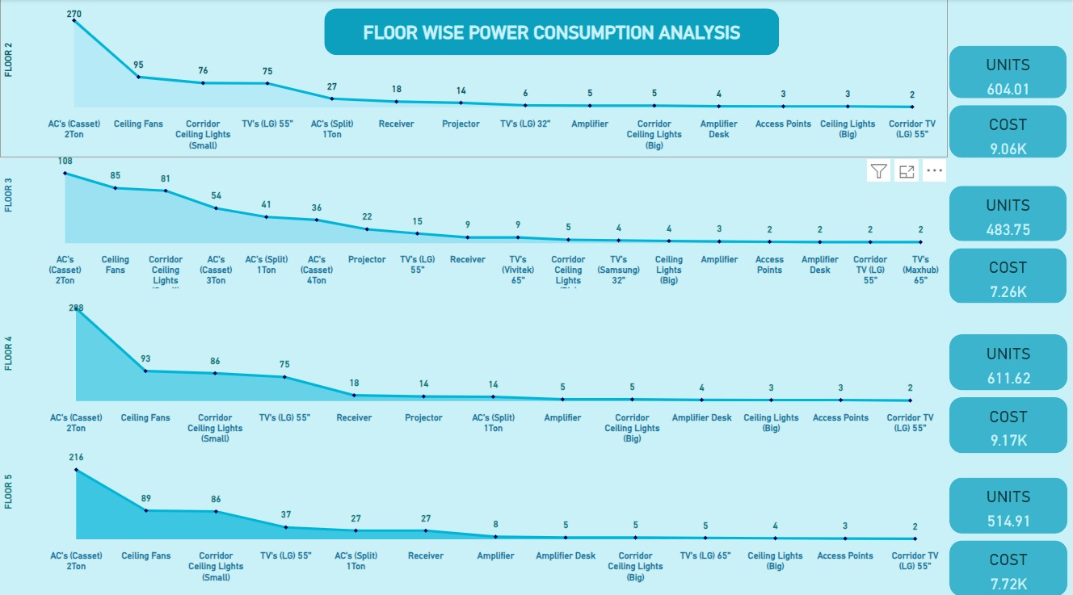

Slide 7






Our Team
P. Satya Surendra
G. Hemalatha
S. Gopichand
Data Analyst
Data Analyst
Data Analyst
P. Chandrapoorna
M. Manoj
D. Pooja
Data Analyst
Data Analyst
IoT Developer

Slide 8
THANK YOU

